Slide 1

Stage 7 Always Has Been Course Designer: Jordan Rogers
Always Has Been is a 31 round, 155 point Comstock long course. There are 12 USPSA targets and 7 steel targets. The best two hits per target will score. Steel must fall to score. The start signal is audible.
The Handgun start position is standing outside the shooting areas with toes touching any fault line. Handgun loaded and holstered and wrists below belt. The PCC start position is standing outside the shooting area with toes touching any fault line. PCC loaded and stock touching belt.
On the audible start signal, engage targets from within the shooting areas.

Slide 2
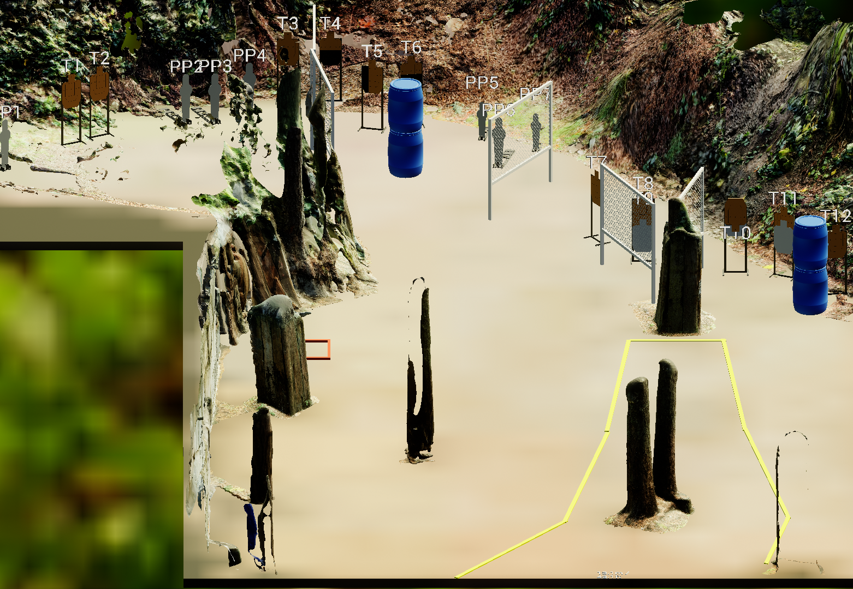
 | Stage 7 Always Has Been Course Designer: Jordan Rogers

